Slide 2
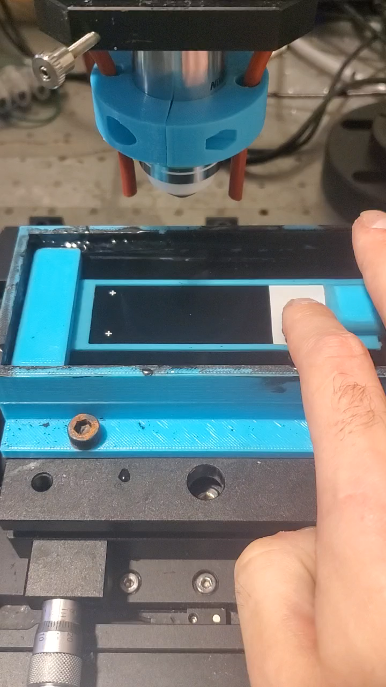
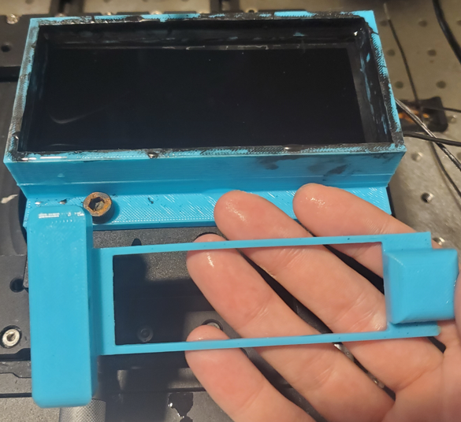
New Chamber for Gutage
Needed flexibility to place invisi-slip fluidic device anywhere lengthwise on slide
Needed more robust alignment jig, durability and repeatability wise
TMA could be in varied locations

Slide 3
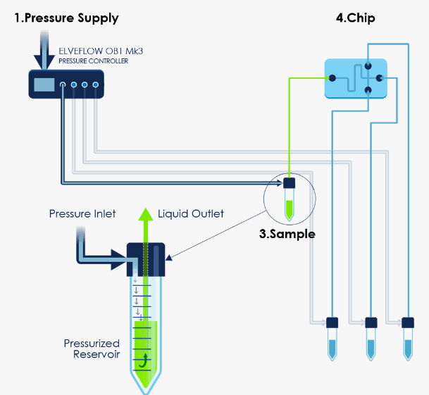
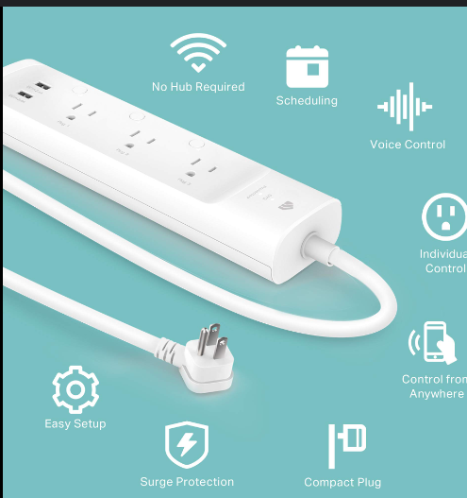
Digital Back Flips for Fluidic System
Unreliability in fluidic system stemming from system freezes and not accepting commands
Python
Resend command
Tell power strip to power cycle OB1
Didn’t respond to command
Frozen Flow meter
Plugged into smart power strip

Slide 4
Cluster Filtering
Wastes time and storage space to image areas with no tissue.
Segmenting nuclei and dilating creates a binary map of tissue
It also will sporadically create non tissue based clusters which need filtered out
Approach: take X seed clusters and any cluster greater than 10% of the area of the smallest cluster

